Slide 1
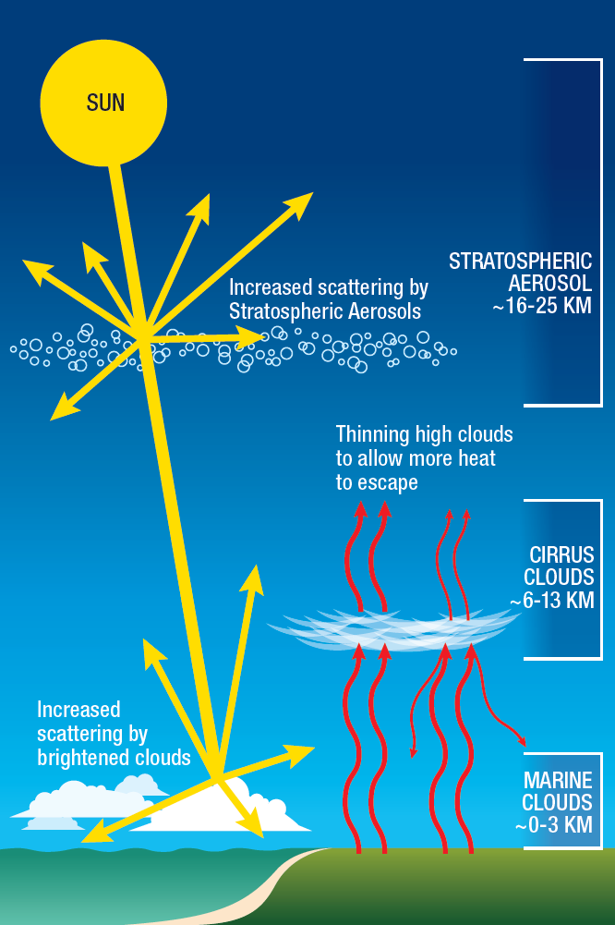
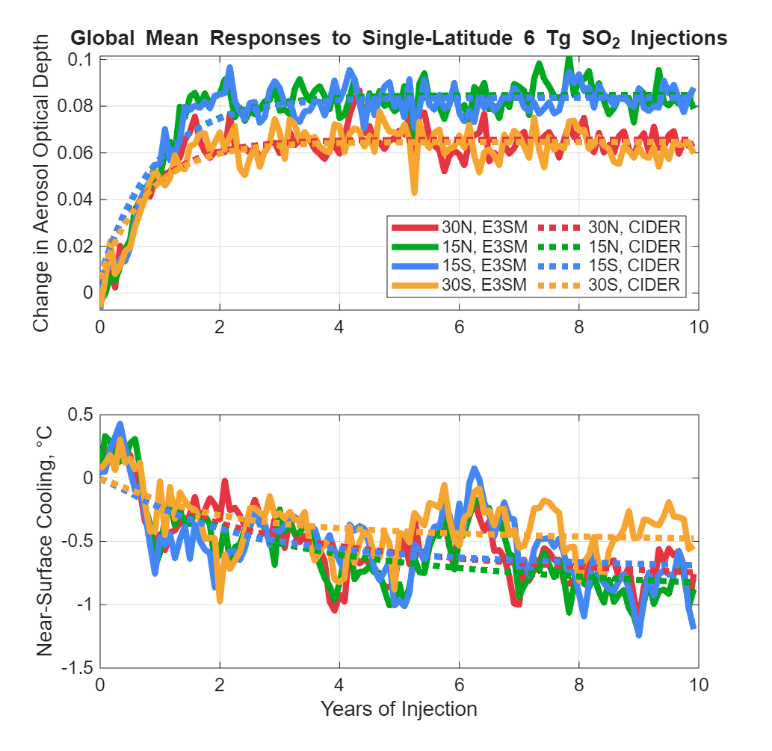
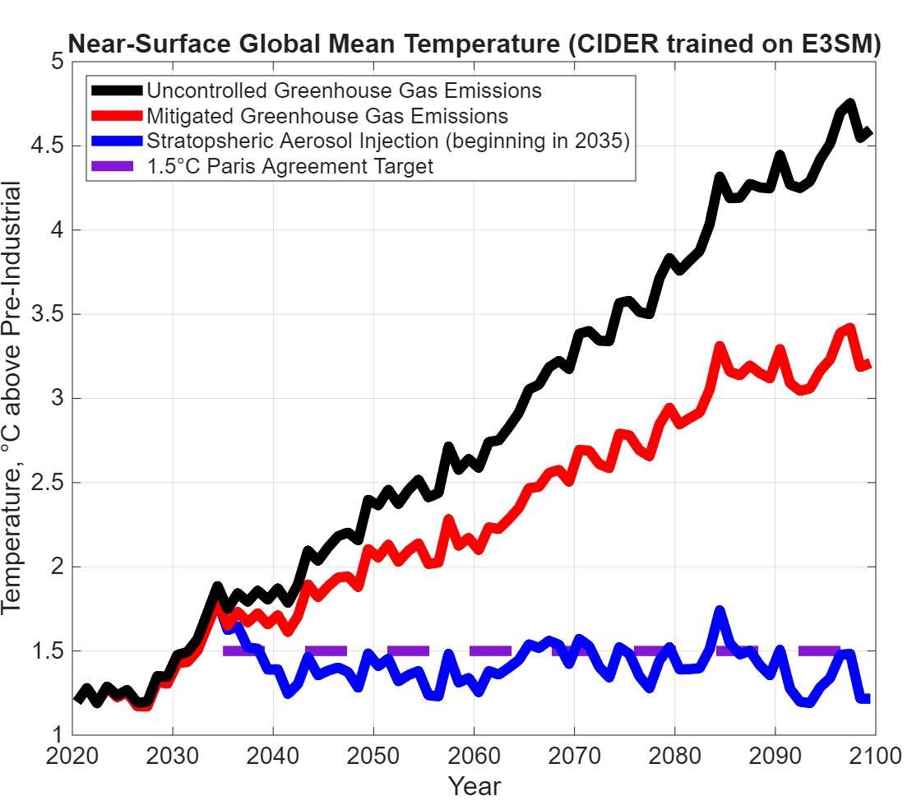
Stratospheric Aerosol Injection Emulation for Controller Design
Jared Farley^{[a][b]}, Benjamin Wagman^{[b]}
[a] Cornell University, Mechanical Engineering Ph.D., 2026 [b] 8931. Sandia National Laboratories/NM, U.S. Department of Energy
Context:
Greenhouse gas emissions raise global surface temperatures by trapping outgoing infrared radiation.
Stratospheric Aerosol Injection (SAI) cools surface temperatures by lofting droplets into the middle atmosphere and scattering incoming sunlight.
SAI studies often use a feedback controller to correctly set the amount and location of injection for a desired climate.
Earth System Models (ESMs) are often tedious or expensive to run, so coupling with a simpler model is desired for rapid or experimental controller design.
Emulation of ESMs (e.g. the DOE model E3SM [1]) will allow for deeper exploration and understanding of SAI capabilities.
Results:
Climate Intervention Dynamical EmulatoR (CIDER) [2] trained to mimic E3SM at a fraction of the computational cost.
(National Academy of Sciences, 2021)
E3SM Cost per Simulated Year | CIDER Cost per Simulated Year
1.2 million core hours | 11 core seconds
SAI feedback controller [3] [4] [5] coupled with CIDER can maintain global mean temperature target, even in the presence of rising greenhouse gas concentrations.
Matching E3SM simulation
in progress!
Conclusions:
E3SM-trained CIDER can be used for SAI controller testing and design.
The current state-of-the-art control algorithm seems to be able to control the climate in E3SM via SAI.
References:
[1] Jean-Christophe Golaz, Wuyin Lin, Xue Zheng, et al. The Energy Exascale Earth System Model version 3. Part II: Overview of the coupled system. ESS Open Archive. https://doi.org/10.22541/essoar.175097464.44666291/v1 June 26, 2025.
[2] Farley, J., MacMartin, D. G., Visioni, D., Kravitz, B., Bednarz, E., Duffey, A., and Henry, M.: A Climate Intervention Dynamical Emulator (CIDER) for Scenario Space Exploration, EGUsphere [preprint], https://doi.org/10.5194/egusphere-2025-1830, 2025.
[3] Kravitz, B., MacMartin, D. G., Mills, M. J., Richter, J. H., Tilmes, S., Lamarque, J.-F., Tribbia, J. J., and Vitt, F.: First simulations of designing stratospheric sulfate aerosol geoengineering to meet multiple simultaneous climate objectives, J. Geophys. Res.-Atmos., 122, 12616–12634, https://doi.org/10.1002/2017JD026874, 2017.
[4] MacMartin, D. G., B. Kravitz, S. Tilmes, J. H. Richter, M. J. Mills, J.-F. Lamarque, J. J. Tribbia, and F. Vitt, 2017: The climate response to stratospheric aerosol geoengineering can be tailored using multiple injection locations. J. Geophys. Res. Atmos., 122, 12 574–12 590, https://doi.org/10.1002/2017JD026868
[5] Richter, J. H., Visioni, D., MacMartin, D. G., Bailey, D. A., Rosenbloom, N., Dobbins, B., Lee, W. R., Tye, M., and Lamarque, J.-F.: Assessing Responses and Impacts of Solar climate intervention on the Earth system with stratospheric aerosol injection (ARISE-SAI): protocol and initial results from the first simulations, Geosci. Model Dev., 15, 8221–8243, https://doi.org/10.5194/gmd-15-8221-2022, 2022.
SAND2025-09141D

